Slide 1
BaNK MAKETING
Descriptive Analytics Project
Zahra Reyhanian
December 2022

Slide 2
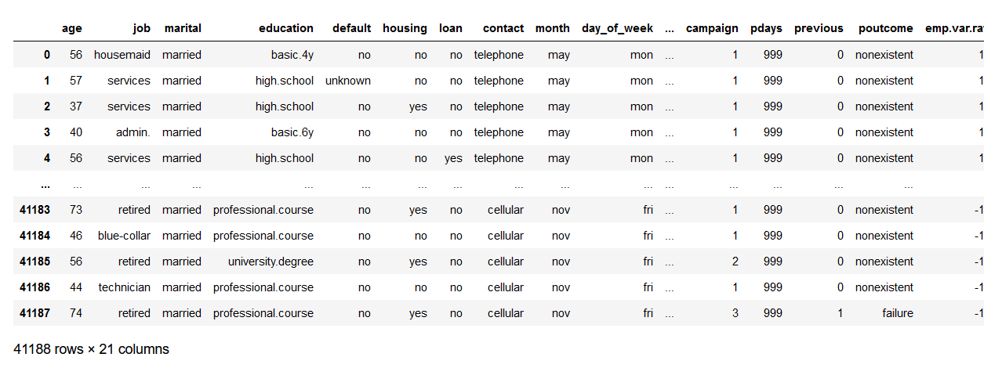
Data Contents

Slide 3
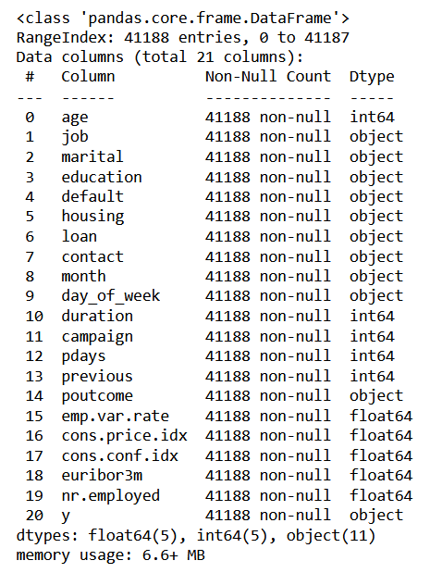
Dataset Information

Slide 4
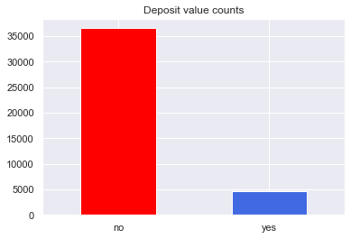
Distribution of target value

Slide 5
Exploratory Data Analysis for categorical variable

Slide 6
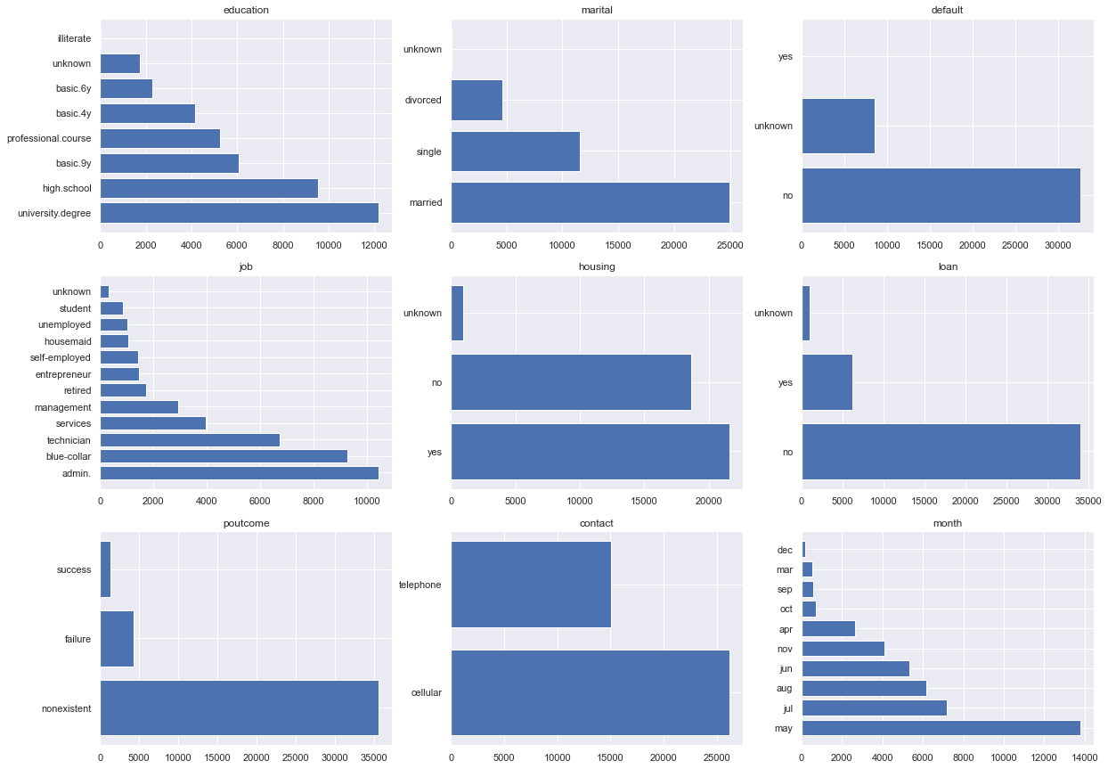

Slide 7
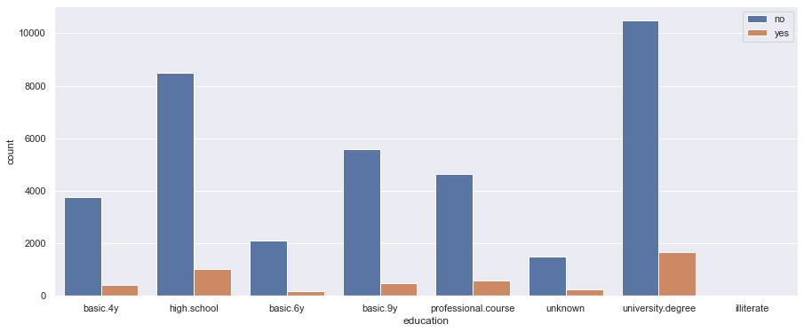
Bar plot of education according to y

Slide 8
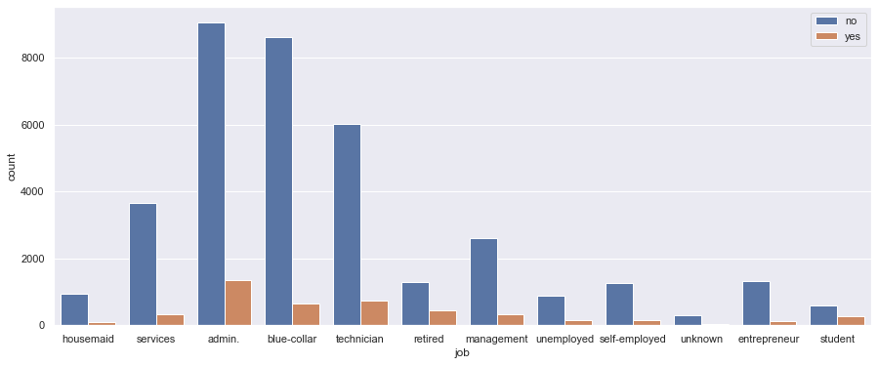
Bar plot of job according to y

Slide 9
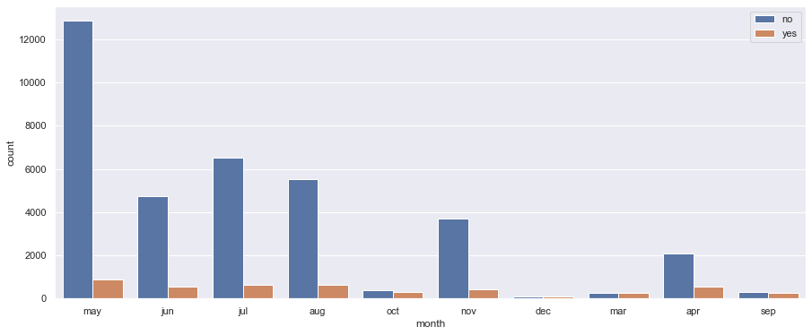
Bar plot of month according to y

Slide 10
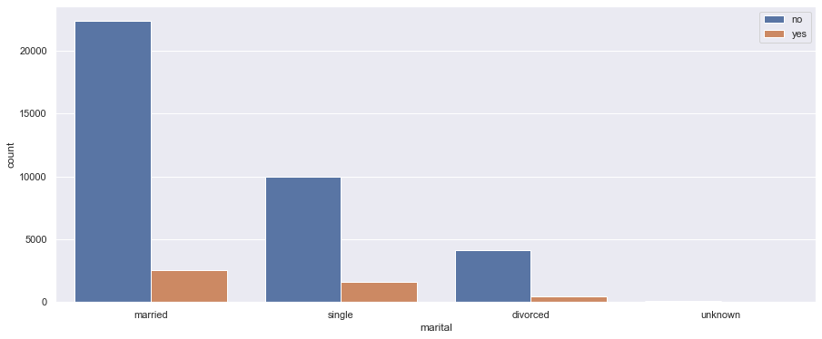
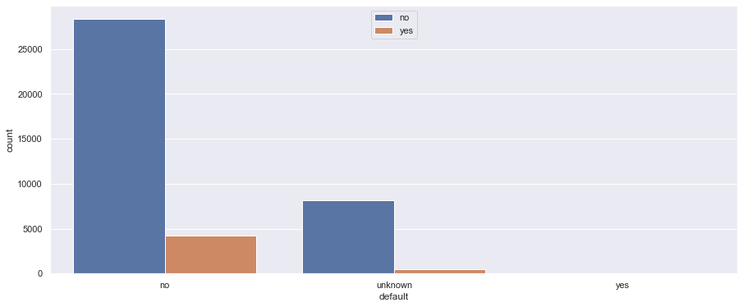
Bar plot of marital according to y
Bar plot of default according to y

Slide 11
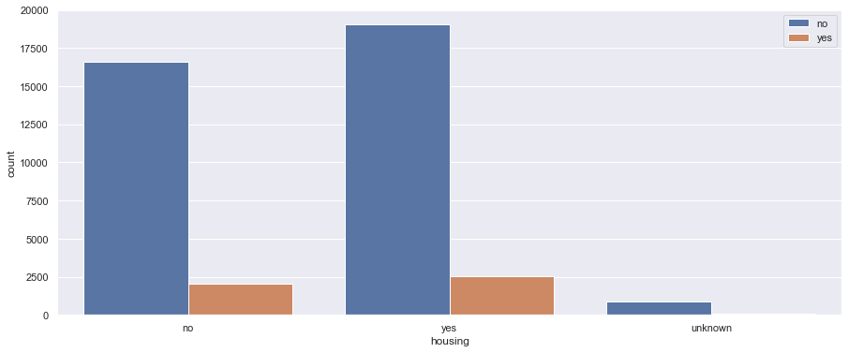
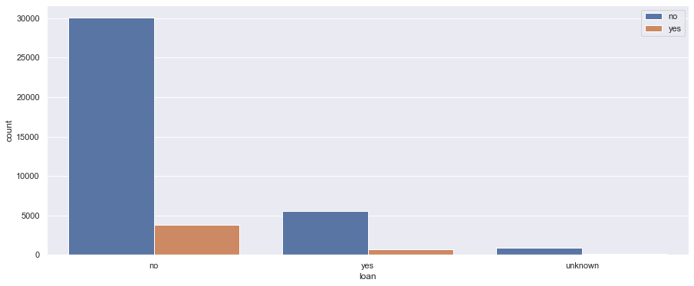
Bar plot of housing according to y
Bar plot of loan according to y

Slide 12
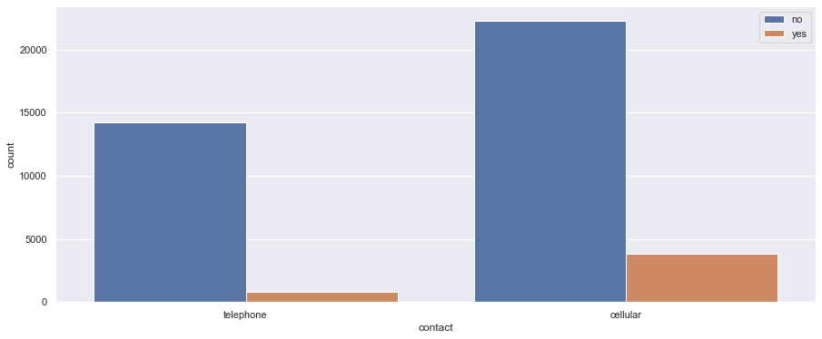
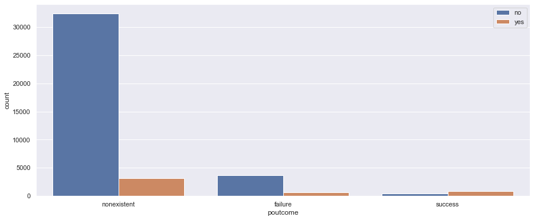
Bar plot of contact according to y
Bar plot of poutcome according to y

Slide 13
Exploratory Data Analysis for NUMErical variable

Slide 14
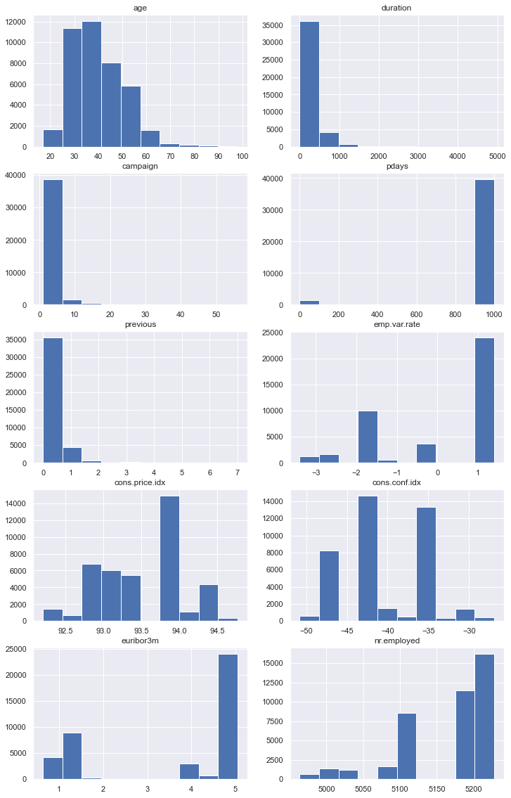
Histogram of Numerical Data

Slide 15
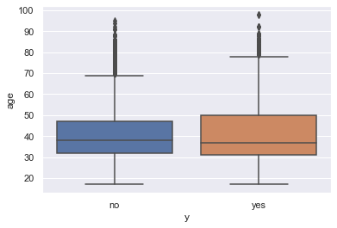
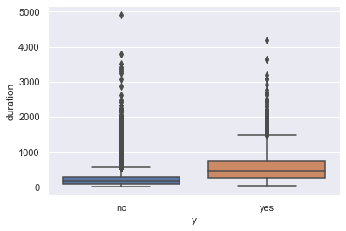
Box plot of age according to y
Box plot of duration according to y

Slide 16
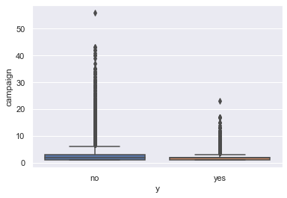
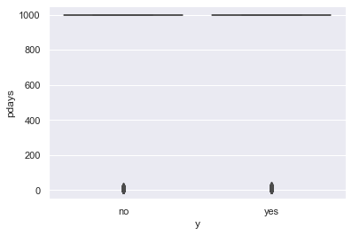
Box plot of campaign according to y
Box plot of pdays according to y

Slide 17
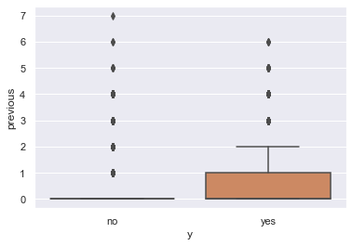
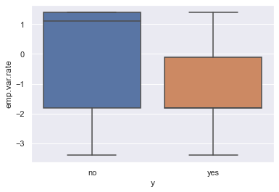
Box plot of previous according to y
Box plot of emp.var.rate according to y

Slide 18
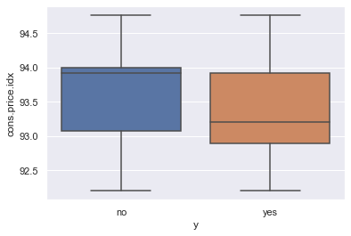
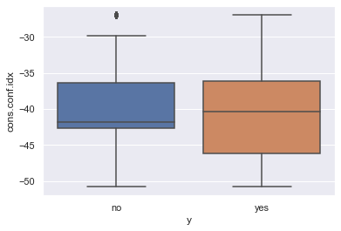
Box plot of cons.price.idx according to y
Box plot of cons.conf.idx according to y

Slide 19
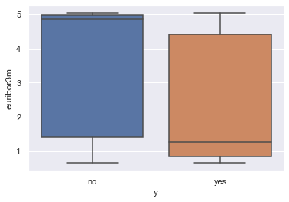
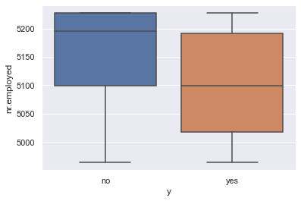
Box plot of euribor3m according to y
Box plot of nr.employed according to y

Slide 20
CorRelation Between Features

Slide 21
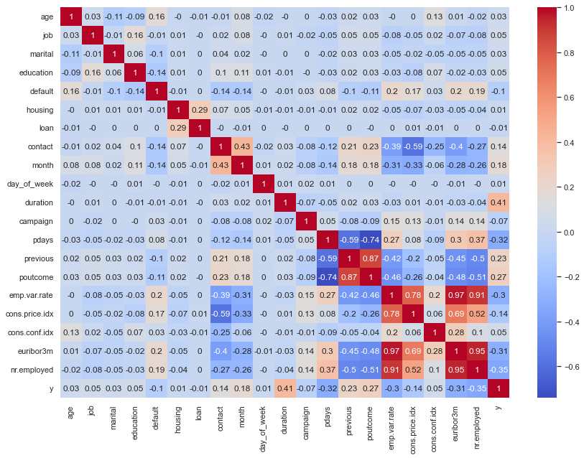

Slide 22
Dimensionality Reduction Using PCA and LDA

Slide 23
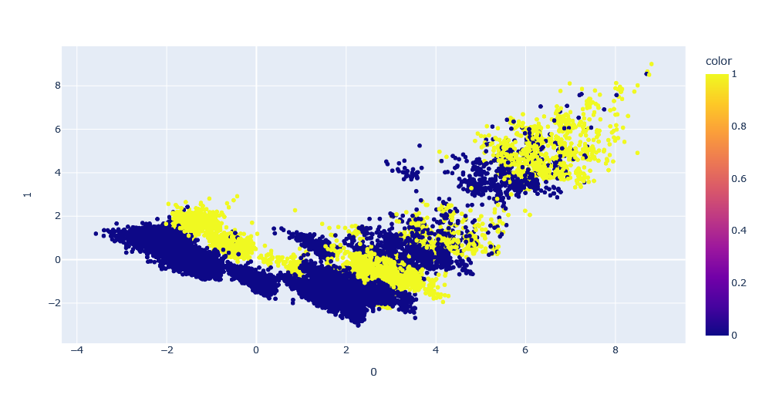
Principal Component Analysis (PCA)

Slide 24
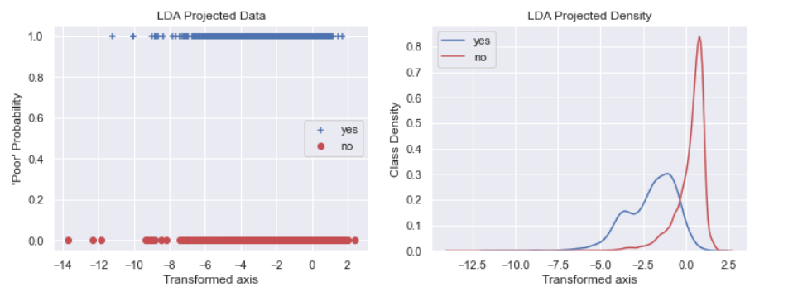
Linear discriminant analysis (LDA)

Slide 25
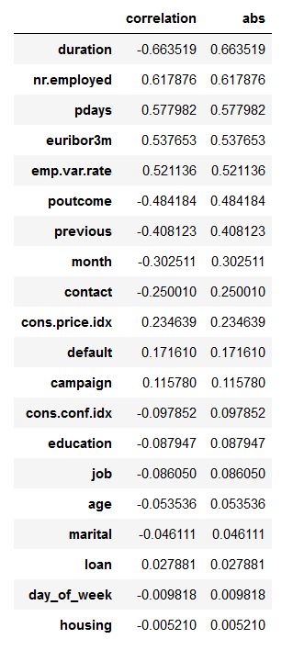
The correlation of the LDA transformation
and each feature

Slide 26
The END

